Slide 1


Class & Comp Study
An Update to YCCD Governing Board
September 10, 2026

Slide 2

Agenda
Purpose
Classification Study
Compensation Study
Implementation

Slide 3
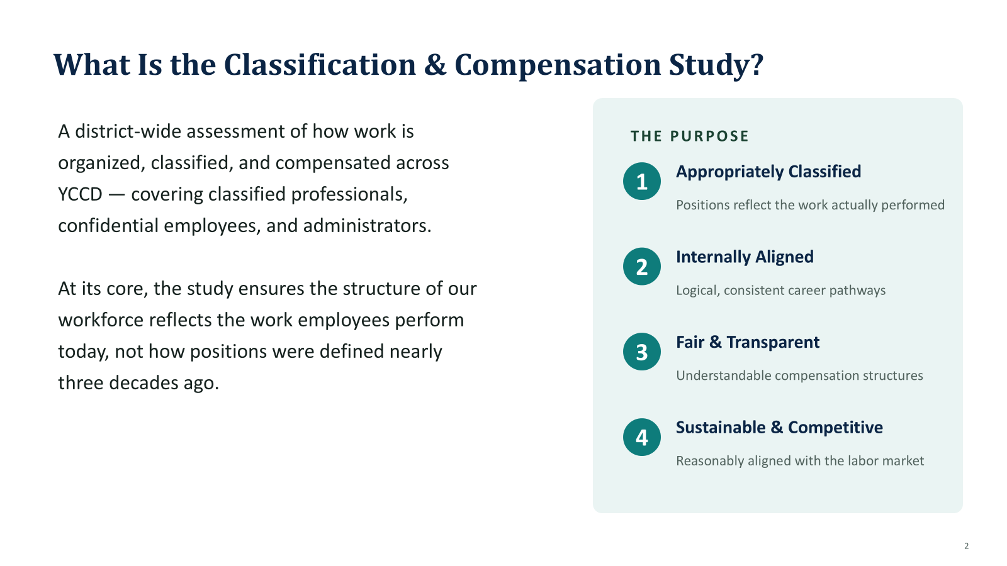

Slide 4
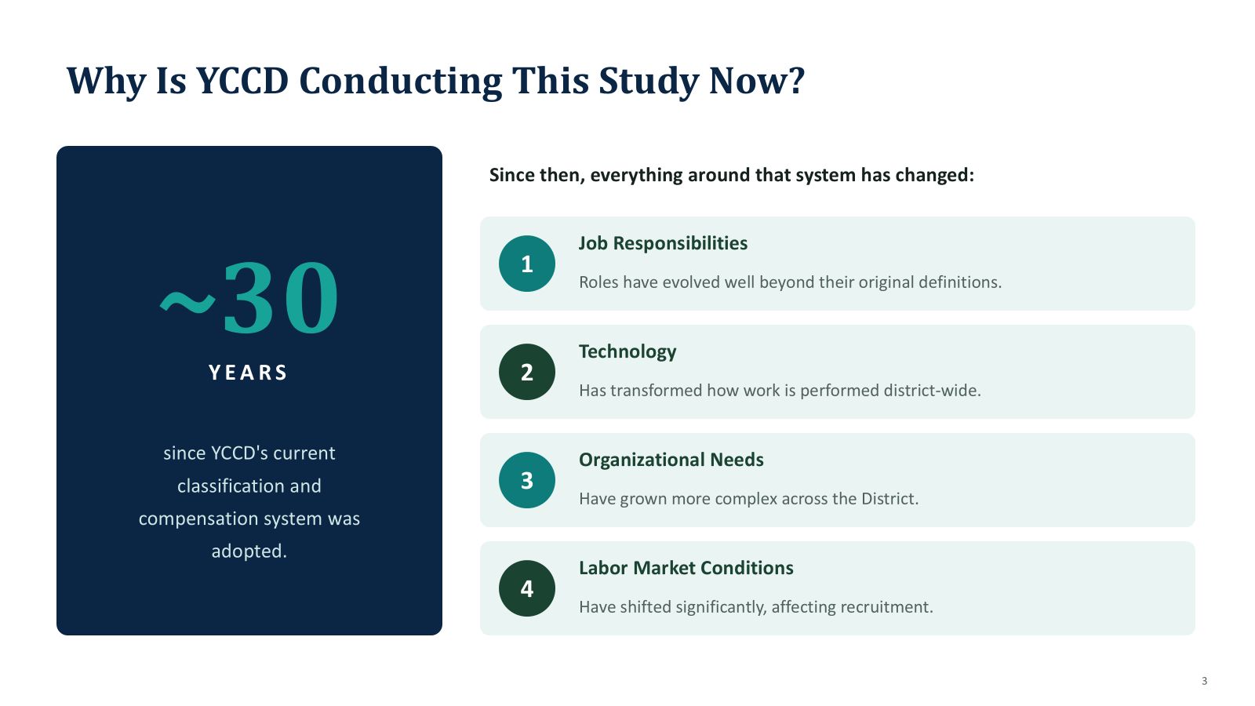

Slide 5
Addressing Persisting Issues
1. To create a modern, comprehensive classification and compensation system;
2. To tackle systemic recruitment and retention challenges;
3. To address frequent and serious administrative turnover.

Slide 6
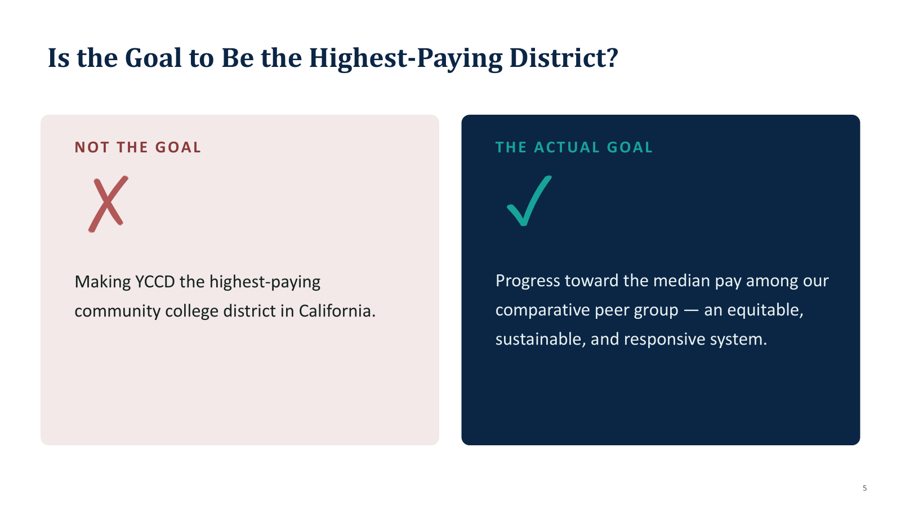

Slide 7
Classification Study
Comprehensive Job Analysis: Examines job roles to understand responsibilities, required skills, and complexities.
Job Grouping: Organizes positions into classifications based on similarities in duties and requirements.
Equity and Fairness: Ensures roles are classified appropriately to promote fairness and consistency in compensation.
Process-Oriented: Includes reviewing job descriptions, conducting employee interviews, and analyzing organizational needs.
Market Comparison: Benchmarks classifications against external standards to align with industry practices.
Outcome-Focused: Establishes a foundation for equitable salary ranges and supports strategic workforce planning.

Slide 8

What is a Job Family?
Job families are groupings of jobs related by common vocations/professions. Accordingly, they have many similarities. Jobs in a job family are similar in that they:
Require
Require similar knowledge, skills and abilities (competencies).
Have
Have a continuum of knowledge, skills and abilities that represent a career path from the lowest to the highest level job.
Possess
Possess associated and related key behaviors.
Have
Have similar market competitive pay characteristics and conditions.

Slide 9

Compensation Study
Data-Driven Approach: Uses insights from the classification study to align compensation with job roles and responsibilities.
Market Benchmarking: Compares salary ranges for classified positions against peer organizations and industry standards.
Internal Equity Evaluation: Ensures pay consistency within classifications to address disparities and promote fairness.
Strategic Alignment: Supports organizational goals by attracting and retaining top talent through competitive compensation.
Informed Recommendations: Develops salary ranges and pay structures based on accurate classification data and market trends.
Implementation Planning: Provides a roadmap for transitioning to updated pay structures, including budget considerations and timelines.

Slide 10
Comp Study Steps
Step 1: Identify Labor Market and Conduct Market Analysis
Step 2: Determine Market Position and Salary Structure/Design
Step 4: Implementation Strategies and System Administration/Maintenance
Step 3: Develop Salary Recommendations Based on Market Data and Internal Alignment Principles

Slide 11

Step 1 – Identify Labor Market and Conduct Market Survey
Identify Labor Market
Verify Agencies to Use for Survey
Market Analysis and Results
Utilize Benchmark Classifications (60-70% of job classes)
Typically 10-12 agencies
Salary and Benefits Data Collected by Consultant
Agency Review Consultant’s Market Results

Slide 12
Comparator District Selection
Selection Criteria: The YCCD Institutional Effectiveness team developed a methodology for selecting the comparator districts based on several important criteria that align with our operational needs and labor market. A total of 24 community college districts were evaluated and ranked based on the following factors:
Number of Colleges: Districts with more than one college (multi-college) were prioritized, as they typically share a similar organizational complexity to YCCD.
North Far North Membership: Districts that are part of the North Far North Group were given consideration due to the geographic and economic similarities to YCCD.
Cost of Living Index: The 10 community college districts closest to YCCD’s Cost of Living Index were prioritized to ensure comparable salary levels adjusted for regional cost of living.
Staffing by Full-Time Equivalent (FTE): The 10 districts with staffing levels closest to YCCD’s Fall 2023 staffing FTE were included to compare staffing ratios.
Number of Locations: Districts with a similar number of campuses and centers were considered, ensuring alignment in operational scale.
FTES/FTE Ratio: Districts with a similar Full-Time Equivalent Students (FTES) to Full-Time Equivalent Staff (FTE) ratio were selected to compare the efficiency and workload expectations of the workforce.

Slide 13
I
Independent Consultant
Gallagher
(Formerly Koff & Associates)
Retained by the District in 2021 to lead the Classification and Compensation Study
COMPENSATION COMPARATIVE GROUPS
(institutions with which YCCD competes for talents)
Los Rios CCD
Sierra CCD
Butte CCD
Shasta Tehama CCD
Mendocino CCD
West Hills CCD
Imperial CCD
Salano CCD
Ohlone CCD
Redwoods CCD

Slide 14
Step 2 – Determine Market Position and Salary Structure/Design
Determine Market Position
Market results provide reference point
Consider philosophy and resource availability
Salary Design
Explore Design Options (steps progression, open ranges)
Review Policy and Impact
Verify Method

Slide 15
Step 3
Develop Salary Recommendations
All job classifications assigned to a range in the proposed salary structure
  Set benchmark job classifications to market placement (e.g., median).
  Align non-benchmark job classifications to a surveyed (benchmark) job classification.
  Apply whole job analysis principles for analyzing positions and aligning to benchmark classifications.
  Set standard differential between levels in a series.
  Examine historical pay practices and salary relationships/alignments.
  Review for compaction and internal equity.

Slide 16
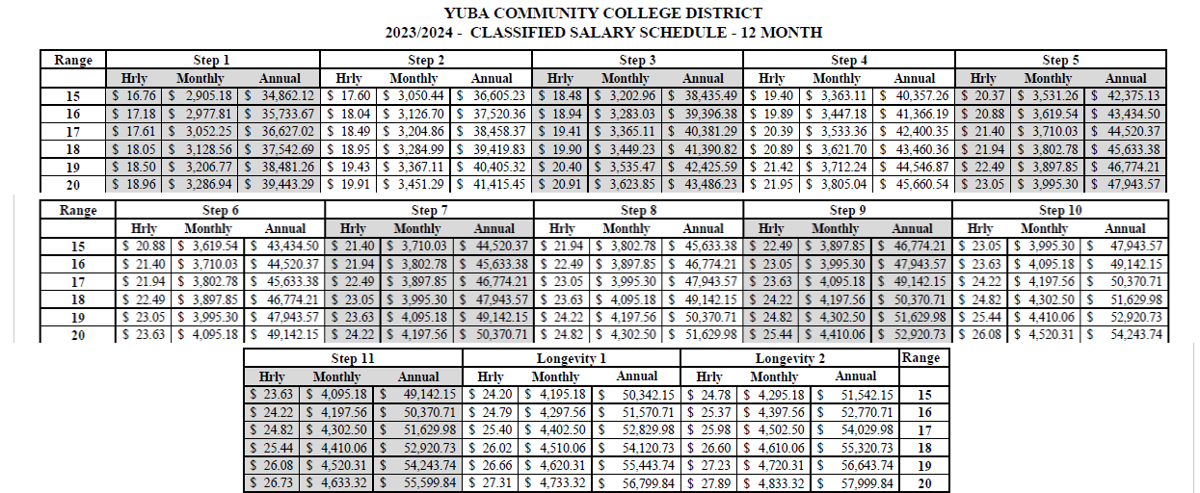
YCCD Salary Schedule Structure
Notes:
Ours takes 16 years to Step 11.

Slide 17
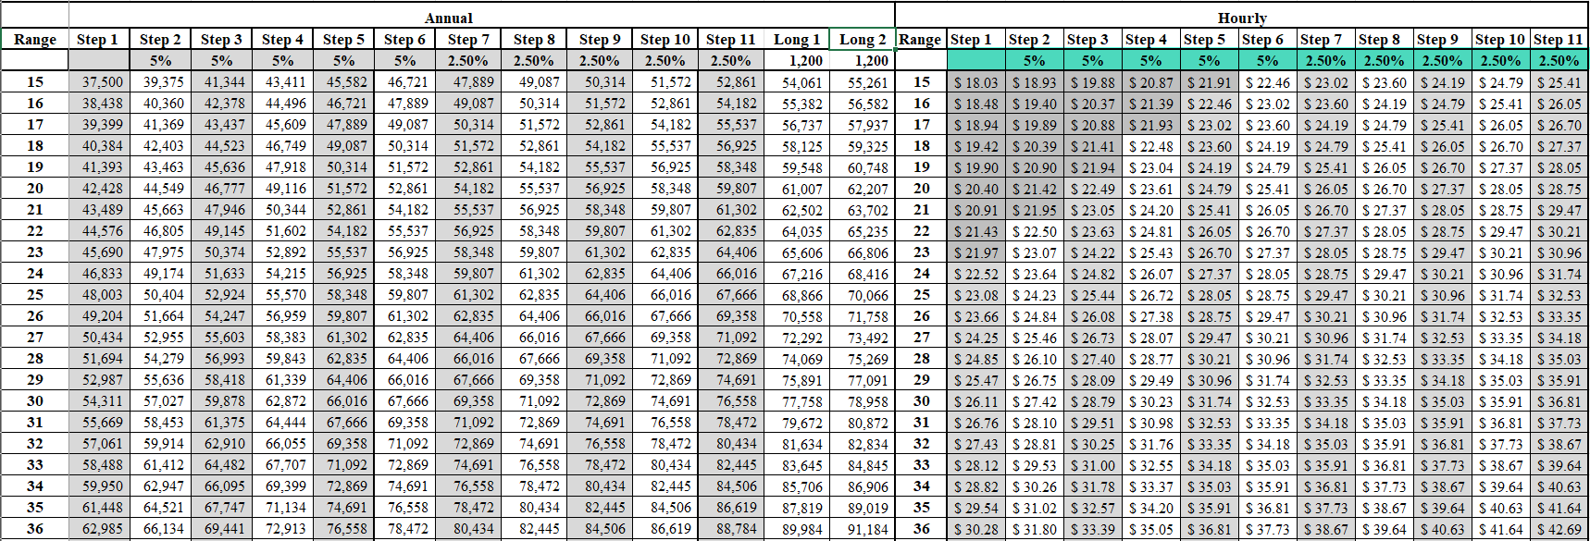
YCCD Salary Schedule Structure 2025-26
Notes:
Current Salary schedule has a 38% overall salary band. However from step 1 it takes 16 years to max out at Step 11.

Slide 18

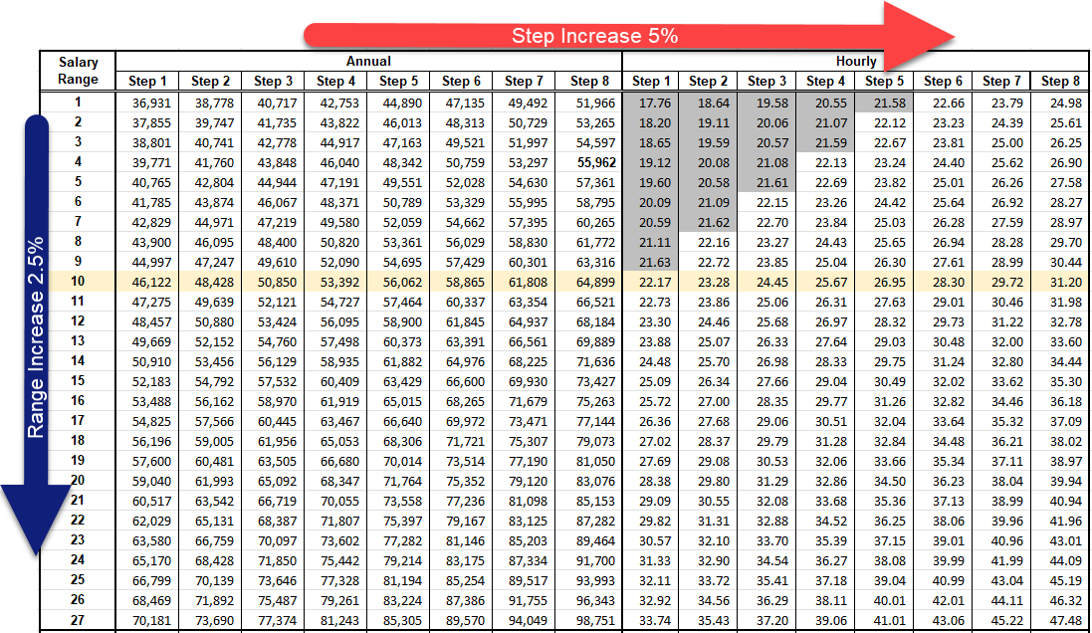
Gallagher Proposed Salary Schedule
FACTORS
Step Increase
5.00%
Range Increase
2.50%
Hours per Year
2,080
Notes:
35% salary band per range – takes seven years from step 1 to top payment.
Old salary schedule took 16 years.

Slide 19

Step 4 - Implementation Strategies and System Maintenance
Policy and resource decisions regarding impacts to individual positions
Implementation options
Multi-Year/Phased Approach
Move to within a certain % of market
Options for job classification proposed to move to lower salary grade ranges
Y-rate
Grandfathering/Attrition
Continue to apply periodic range adjustments to track with CPI or cost of labor via negotiations
Establish standardized practices and policies for range differentials and job leveling differentials

Slide 20
Progress & Milestones
1. District and local CSEA chapter have met eight times to review classification, job families and related issues affecting classification decisions;
2. Four joint sessions (District and Local CSEA Chapter) were held in multiple locations in late July to provide updates and answer questions to Classified Professionals across the District;
4. Classification review for the confidential employees and administrators is underway and is projected to be ready for Board review and action in October.
3. District provided an MOU to CSEA leadership, establishing July 1, 2026 as the common date for Class & Comp changes;

Slide 21
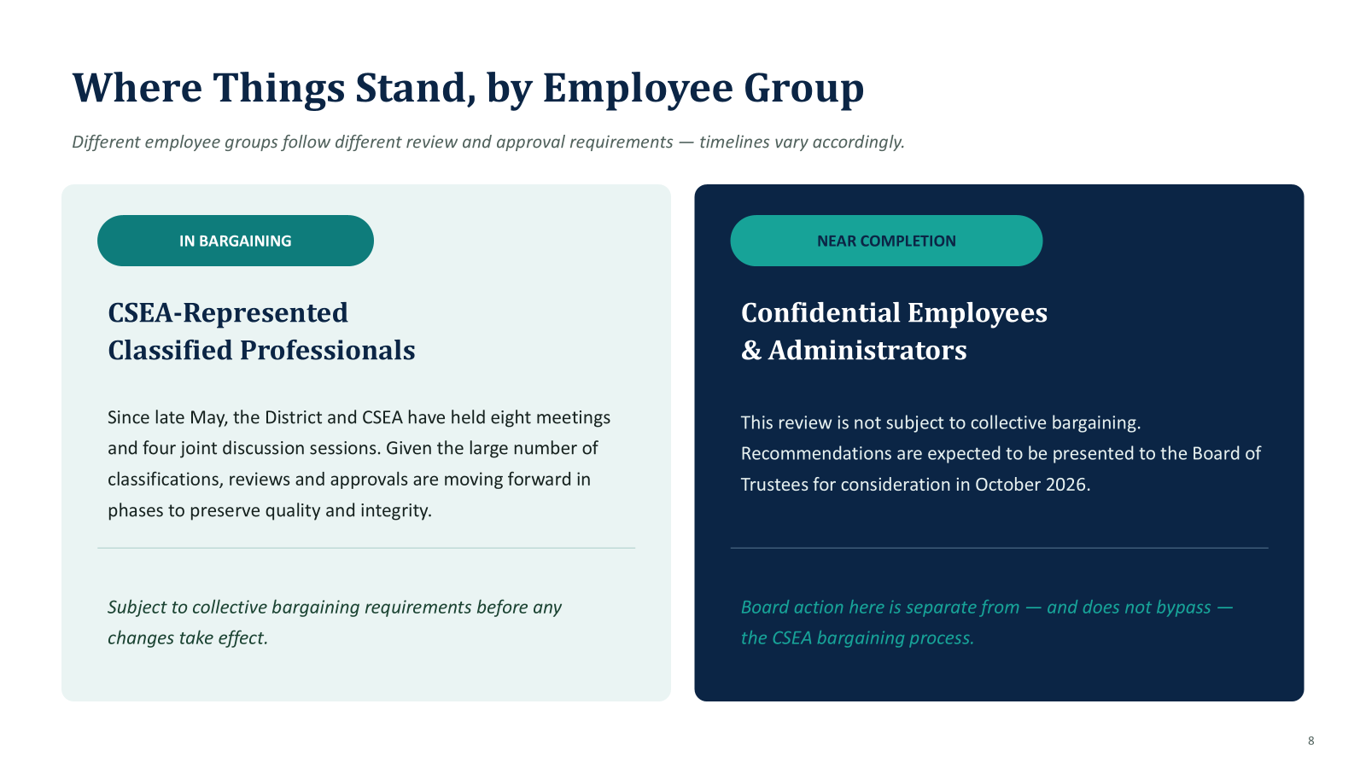

Slide 22
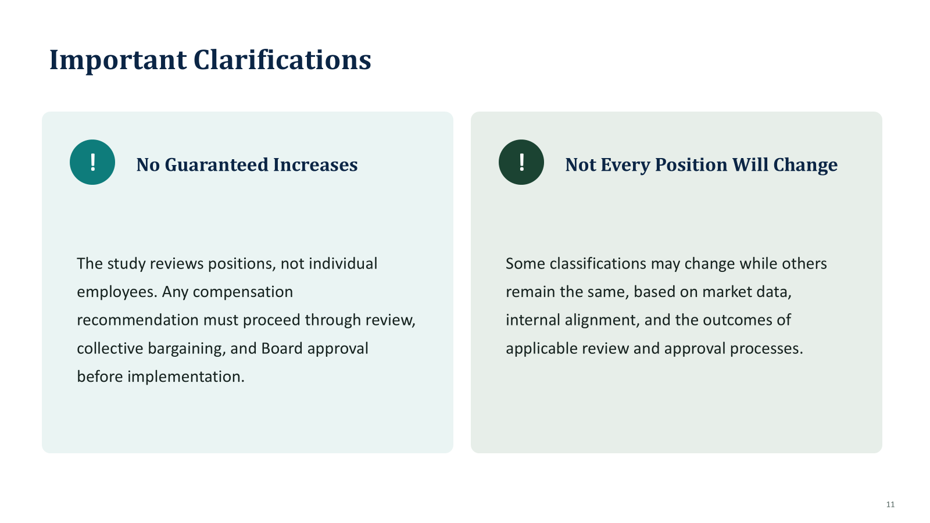

Slide 23
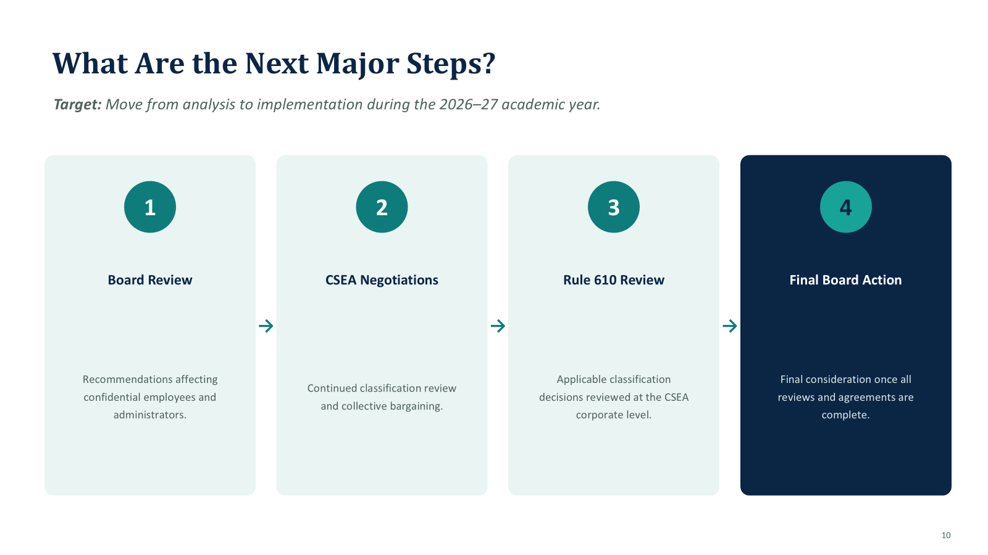

Slide 24
Questions?

