Slide 1
Yuba Community College District

Slide 2
About Koff & Associates
Founded in 1984
As of April 30, 2021, we merged with Arthur J. Gallagher and are now officially a Gallagher Division.
Provide premier public sector human resources services:
Classification and Job Analysis
Compensation and Plan Development
Organizational Effectiveness
Recruitment Services
Partner with:
Cities, Counties, Special Districts, and Others
Straightforward, interactive, all-inclusive methodology
Koff & Associates | koffassociates.com
Notes:
WHAT SETS OUR K&A APART?
80% C&C
Org Effectiveness includes:
Performance Management
Organizational Planning and Development
Human Resources Audits
Employee/Labor Relations
Methodology is solid YET nimble; Incorporates District’s needs into our Methodology; create and implements foundational class and comp systems to support operations
Collaborative approach – involve employees in the process from the beginning
User friendly; call it like we see it.
Consistent messaging.
Well vetted recommendations.

Slide 3
Why We are Here
Classification and compensation study
Classification and compensation relationship
Snapshot in time
Organizational changes
Stakeholder involvement
Employees
Executive Management
Human Resources
Governing Board
Notes:
Classification and Salary Study – incorporate changes that may have occurred within the organization over time
Snapshot in time, with some view into the future

Slide 4
Classification Study

Slide 5
Purpose
Up-to-date & current class plan/descriptions
Ensure legal compliance
Fair Labor Standards Act & Americans With Disabilities Act
Enhance recruitment process
Career paths
Training opportunities
Objective performance evaluations
Equitable compensation system

Slide 6
Classification Study Methodology/Process
Initial meetings with study project team and management
PDQ completion and review
Employee and supervisor interviews
Orientation meetings with employees
Draft class concepts and class descriptions
Employee and supervisor review
Draft and final reports/presentation
Classification training for HR staff

Slide 7
Job Analysis Factors
Decision making/judgment
Difficulty & complexity of work
Supervisory responsibilities
Non-supervisory responsibilities
Minimum qualifications
Working conditions/risk factors
Contacts
Notes:
District is interested in identifying and eliminating any artificial barriers to employment in its classification specifications that may prevent otherwise eligible candidates from successfully applying for employment with the District.
Results in modernized, supported, and clearly interpretable screening criteria and minimum qualifications.

Slide 8
Compensation Study

Slide 9
Comparator Agencies
Benchmark Classifications
Benefits elements
Survey Elements

Slide 10
Comparator Agency Criteria
Labor Market–Geography
Cost of Living
Services and Programs
Organizational Type/Structure
Population, Number of Employees, and Budgets
Each factor analyzed, ranked
Determine similarity

Slide 11
Benchmark Classes
Classes which we anticipate would be common to other agencies
Not every class is a benchmark
Should have relationships to other classes
Benchmark classes are used to set salaries for non benchmark classes

Slide 12
Highly Customized Survey
Job/class descriptions
MOUs
Organizational charts
Salary information
Description-to-description
70% match
Follow-up
All analyses completed in-house
No questionnaires

Slide 13
Sample Top Monthly Data
Administrative Aide
Rank | Comparator Agency | Classification Title | Top Monthly Salary |  | Next Salary Increase | Next Percentage Increase
1 | Comparator 1 | Administrative Assistant | $ 7,077 |  | 7/1/2019 | unknown
2 | Comparator 2 | Administrative Assistant | $ 6,768 |  | 7/1/2019 | 3.00%
3 | Comparator 3 | Administrative Assistant I | $ 6,621 |  | 7/1/2019 | 3.50%
4 | Comparator 4 | Administration Assistant | $ 6,283 |  | unknown | unknown
5 | Comparator 5 | Administrative Aide/Clerical Support | $ 6,275 |  | 7/1/2019 | 2.50%
6 | CLIENT | Administrative Aide | $ 5,956 |  | 7/1/2019 | unknown
7 | Comparator 6 | Administrative Assistant | $ 5,867 |  | 7/1/2019 | unknown
8 | Comparator 7 ¹ | Administrative Services Assistant II | $ 5,603 |  | unknown | unknown
9 | Comparator 8 | Administrative Assistant | $ 5,470 |  | 7/1/2019 | unknown
10 | Comparator 9 | Administrative Coordinator | $ 5,315 |  | 1/1/2019 | 2.00%
11 | Comparator 10 | Office Assistant II | $ 5,288 |  | unknown | unknown
12 | Comparator 11 | Office Assistant II | $ 5,059 |  | 7/1/2019 | 2.00%
13 | Comparator 12 | Office Assistant II | $ 4,565 |  | 7/1/2019 | unknown
Summary Results |  |  | Top Monthly
Average of Comparators |  |  | $ 5,849
% CLIENT Above/Below |  |  | 1.8%
Median of Comparators |  |  | $ 5,735
% CLIENT Above/Below |  |  | 3.7%
Number of Matches |  |  | 12

Slide 14
Statistical Calculations
Median
Midpoint
Not Skewed
Average
Arithmetic Mean
Percentages
Above/Below
Koff & Associates | koffassociates.com

Slide 15
Internal Relationships
Surveyed classifications with lack of data
Non-surveyed classifications
Whole position analysis
Same class series
Scope of work
Organizational “worth”
Past internal relationships
Implementation and strategy development
Plan development, potentially multi-year

Slide 16
Stakeholder Touchpoints
Kick-off & orientations
Supervisor/Management interviews
Class description review
Compensation survey results
Draft and final reports
Presentation to the District’s Board
Notes:
Emphasize ongoing communication throughout the project.

Slide 17
PDQ Completion

Slide 18
Expectations
Not a performance evaluation process
Not a staffing study
PDQs – no changes by supervisor
Classifications are generalized
Not every word from the PDQs will be on the final classification description
PDQs – completed during normal work hours
PDQs – 2 to 4 hours to complete
Koff & Associates | koffassociates.com

Slide 19
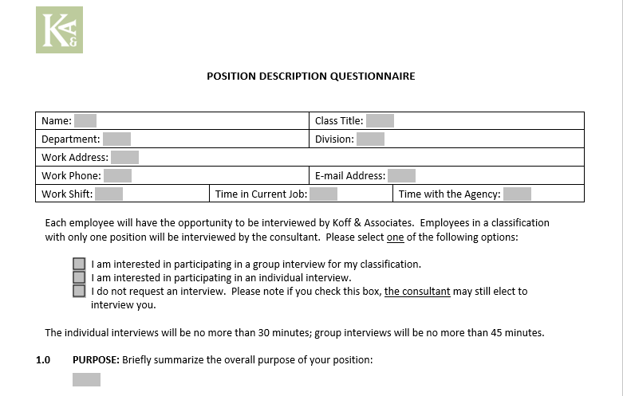

Slide 20
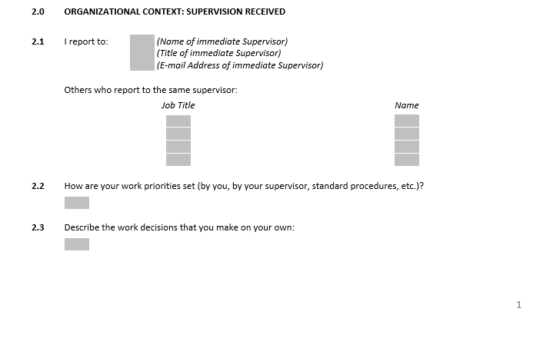
2.0 Organizational Context

Slide 21
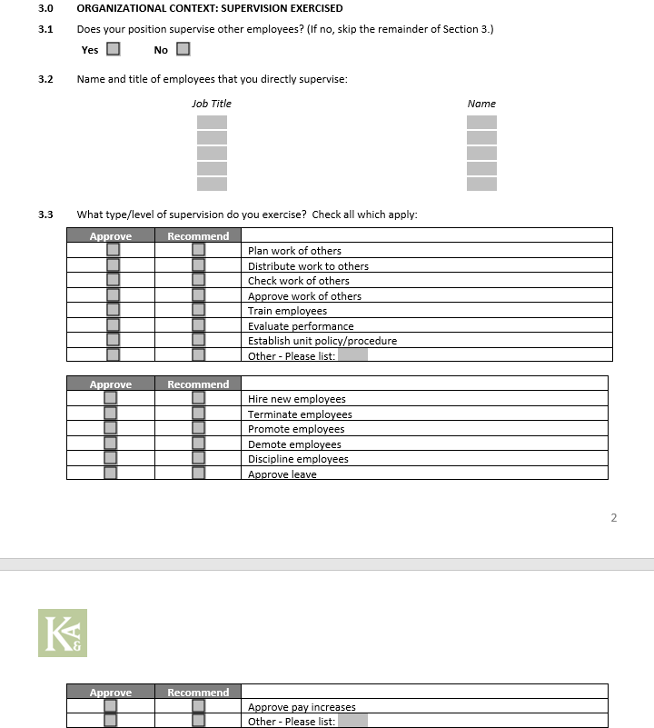
3.0 Supervision Exercised

Slide 22
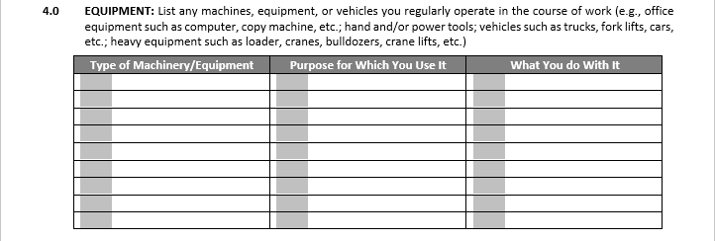
4.0 Equipment

Slide 23
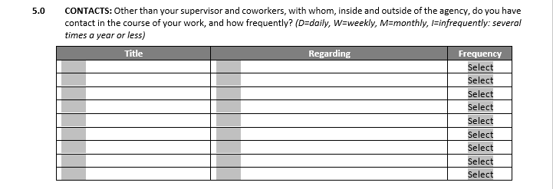
5.0 Contacts

Slide 24
6.0 Budget

Slide 25
7.0 Work/Duties

Slide 26
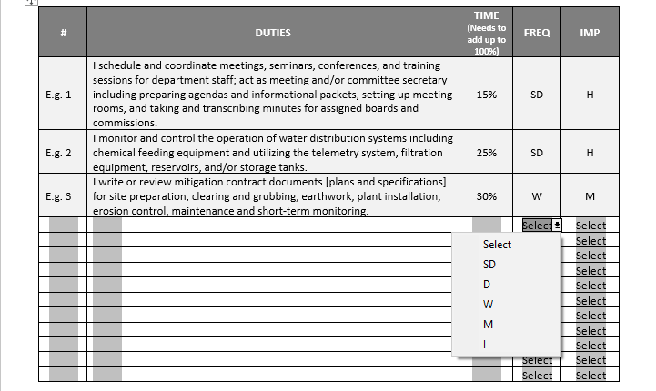
7.0 Work/Duties

Slide 27
8.0 Complex Duties &
9.0 Position Changes

Slide 28
10.0 Sensory Demands

Slide 29
11.0 Physical Demands

Slide 30
12.0 Environmental Conditions

Slide 31
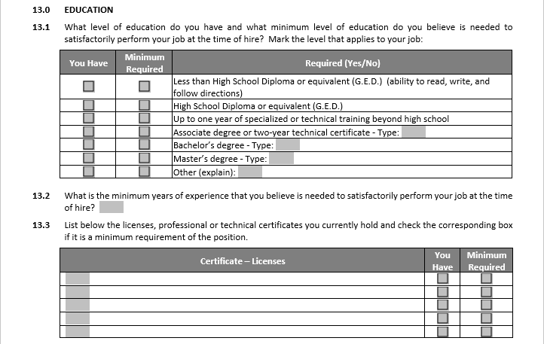
13.0 Education

Slide 32
14.0 Job Qualifications

Slide 33
15.0 Study Expectations

Slide 34
PDQ Completion: Last Page
Supervisor/Management Review
Not a performance evaluation
No content changes, comments only

Slide 35
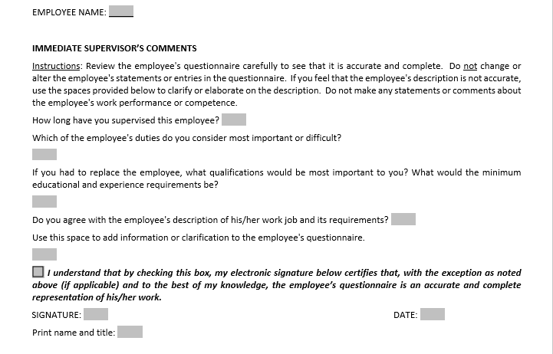
Supervisor Comments

Slide 36
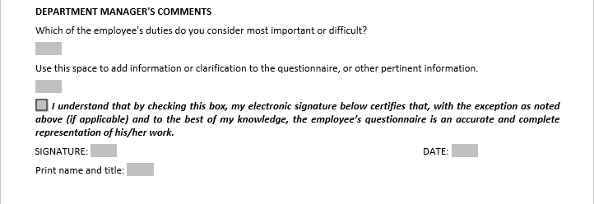
Manager Comments

Slide 37
Proposed Timeline – PDQs
Employee Orientations
October 4,5,6,7,10
PDQs to Supervisor
October 24
PDQs to K&A
November 7
Interviews First 2 Weeks in December
PDQs to Manager
October 31

Slide 38
Questions and Comments
Koff & Associates | koffassociates.com

