Slide 1
Town Hall 16.0 Yuba Community College District
Monday, October 5, 2020

Slide 2
Housekeeping
All participants are muted; please use chat feature to ask questions
We’ll answer questions at the end
Questions and answers will be recorded and posted at YCCD Coronavirus Website
This Town Hall is being recorded and will be posted online

Slide 3
Town Hall Topics
Welcome/Housekeeping/Announcements – Douglas Houston
Health Officers Update – Dr. Mary Ann Limbos and Dr. Rice
Foundation Update – Jay Lowden
College Updates – Tawny Dotson and Art Pimentel
Strategic Planning – Sonja Lolland
Guidance During Wildfire Smoke Events – Kuldeep Kaur
Data Integrity – Cassie Leal
Update Cell Phone for Catapult – Devin Crosby
Wrap Up – Douglas Houston

Slide 4
Health Officers’ Update
Dr. Mary Ann Limbos, Yolo County Deputy Health Officer Yolo County Health and Human Services Agency
Dr. Homer Rice, Deputy Director for Health and Human Services Department (HHSD), Yuba County

Slide 5

Foundation Update

Slide 6

In 6 Words, Why I Give
In 6 words complete the statement I Give to… and email your statement to: foundation@ yccd.edu
I give to provide opportunity and support student success

Slide 7

Woodland Community College Update
Professional Development Day - Focus on Equity and Guided Pathways
Early Alert System at WCC
Health Services RFP Released
LCC Town Hall Scheduled for Thursday, October 8th
Virtual Transfer Fair

Slide 8

Yuba College Update
Fully-funded testing center
Enrollment Planning
2nd SSS Grant ($1.3M)
2020 Yuba-Sutter Best

Slide 9
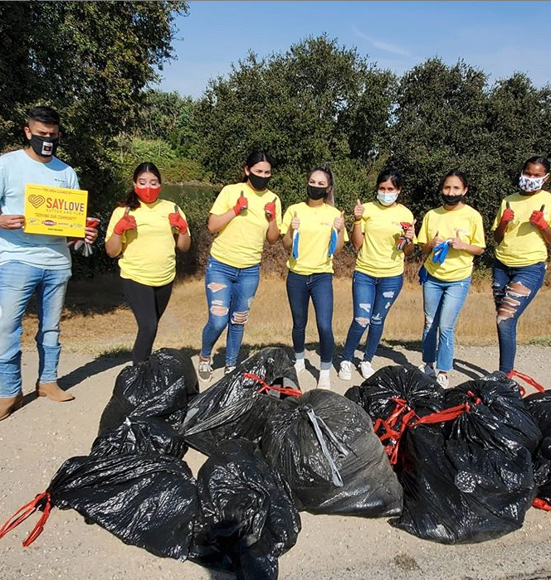
The Yuba Women's Soccer team volunteered at the Sept. 26 SayLove community clean up event. #YCProud

Slide 10
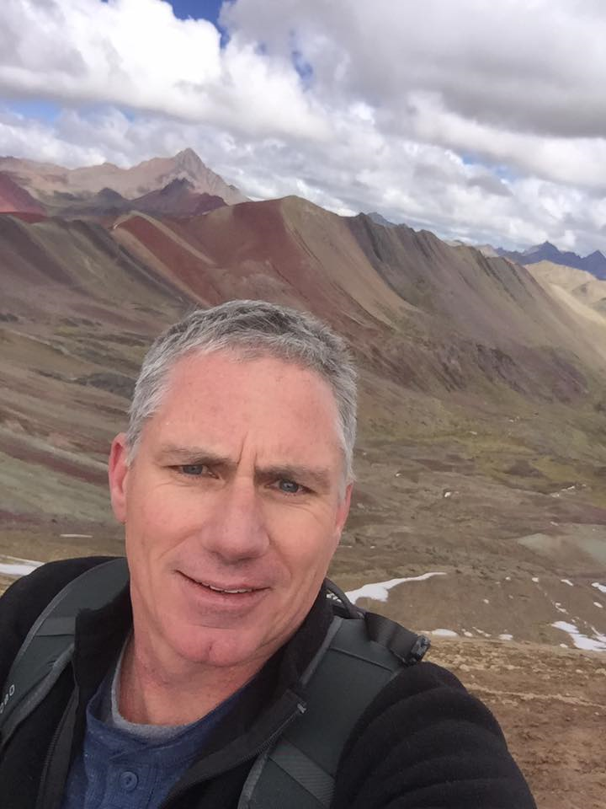
#YCProud
Physical Sciences Professor Korey Champe has taken the lead in the process of improving education in general. He is not afraid of the tough stuff and wants to fix things to all better reach our students. Korey launched his first online class in the Spring 2020 Semester before the pandemic and hopes to have a fully-online lab course validated by the summer of 2021. He has been a founding member of the Early College High School dual enrollment faculty team in its second year, mentoring other faculty in how to reach the unique student population. Korey has participated in regional science discussions with the Yuba Water Agency. Korey feels "The College" is our job, not just the classroom, and it makes a difference for all of us at Yuba College.
Korey's secret for reaching students is to "make sure they know I am not above them" and that "it starts with respect and demands fairness." If he could reform his science education discipline, he would be bringing everyone outside to discover the science all around us.

Slide 11
Strategic Planning Yuba Community College District

Slide 12
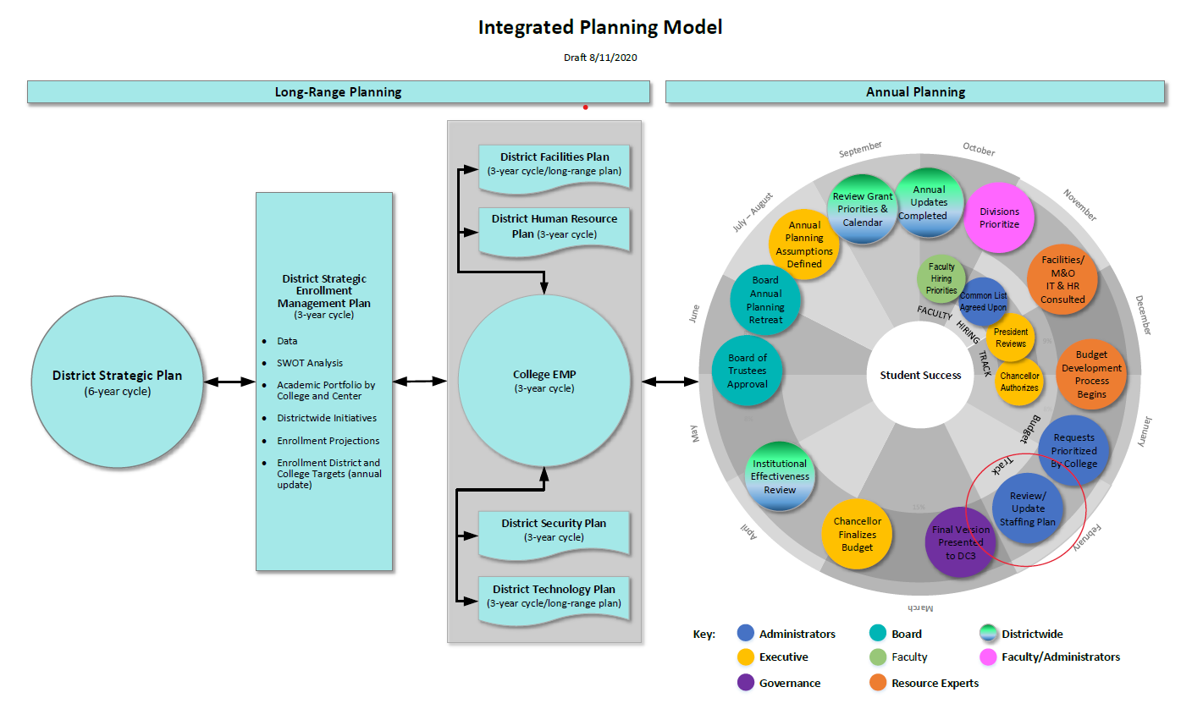

Slide 13
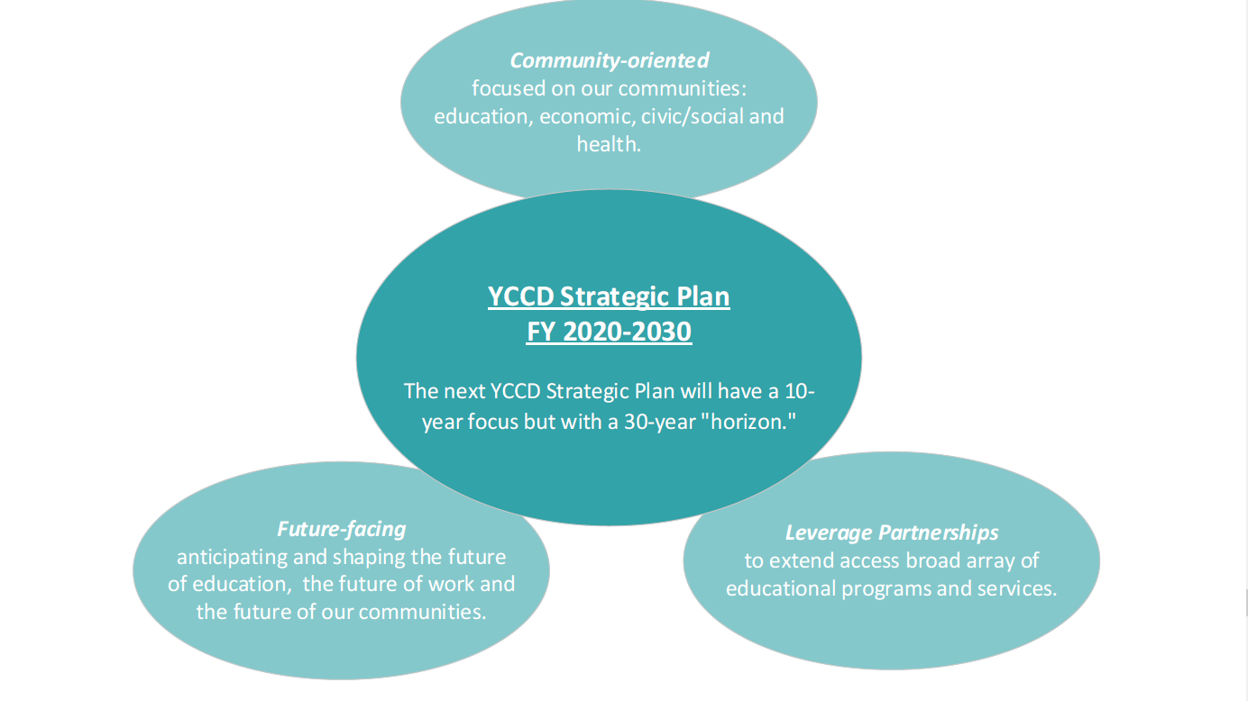
Guiding Principles: Future Facing, Community Oriented & Leverage Partnerships

Slide 14
Future Facing: 10 Year Focus with a 30 Year Time Horizon
Work collaboratively to answer such questions as:
Who are the college students of 2030? What are their needs?
What is the future of teaching and learning?
What does the higher education environment look post Covid-19?
How will our rural district fulfill our evolving mission?
Change our Planning: Institute tools and practices to identify and monitor signals, forces and challenges that are indicative of impending changes that may impact current and future learners.

Slide 15

Why Develop a Future Facing Culture?
“Often, we have observed that disagreements or inconsistencies in people’s ideas about these things (the future of education) lead to breakdowns of community, productive conflict, and/or trust.”
“Being future ready means to decrease these breakdowns of communication and trust, and boost active co-construction of the futures we want together via inclusion, creation of vibrant and open spaces of dialogue and equitable processes.”
Source: Portland State Futures Collaboratory

Slide 16
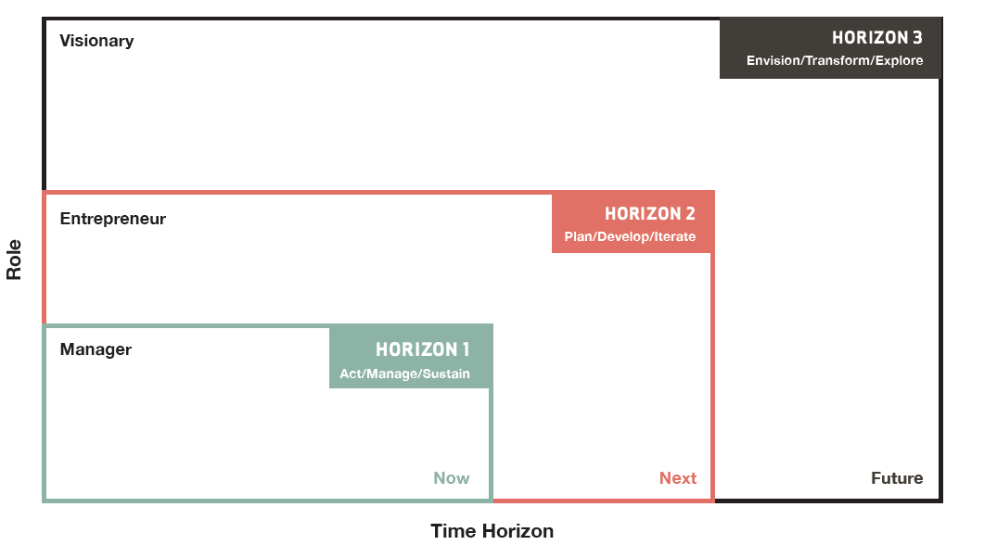

Covid-19: Challenging, but also an opportunity…..

Slide 17


Slide 18
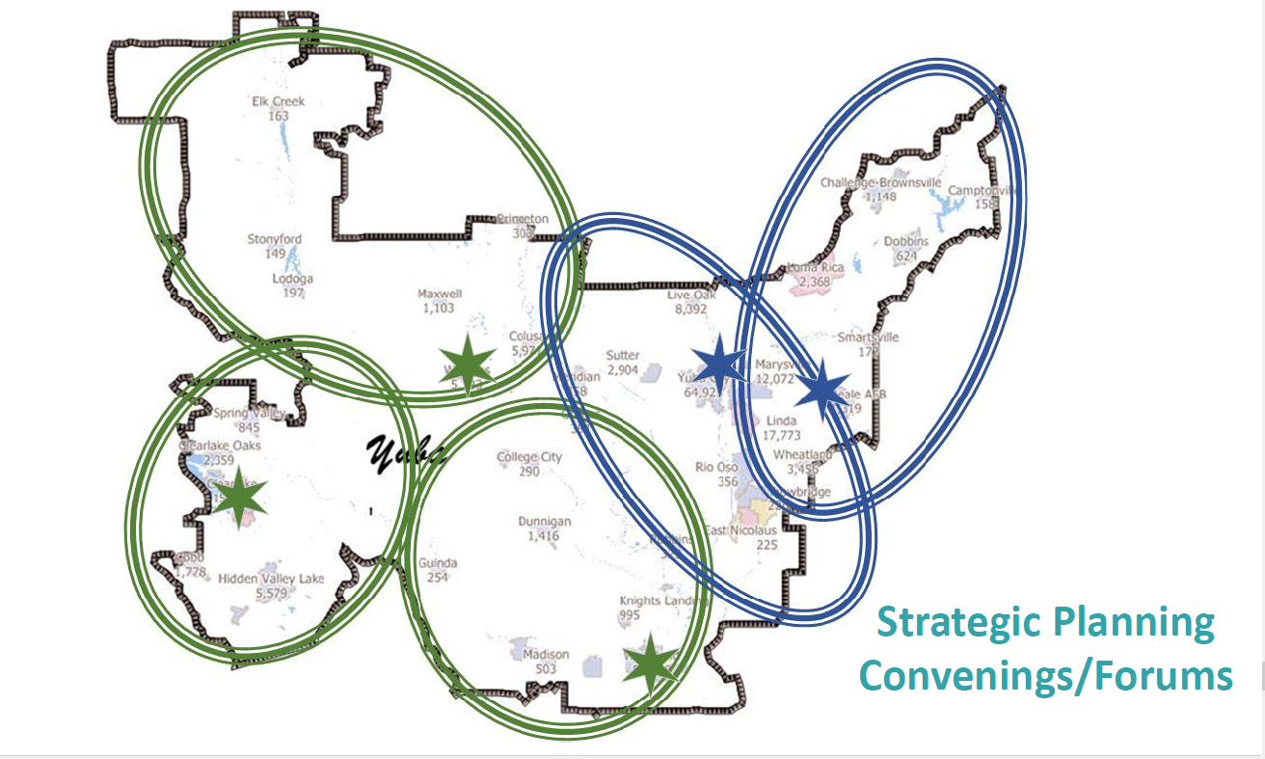

Slide 19
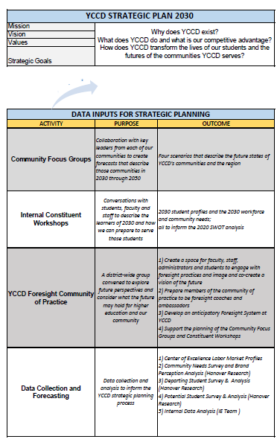

Slide 20
Guidance During Wildfire Smoke Events
Air Quality Monitoring:
There are a number of online sources that measure the Air Quality Index (AQI), these sites vary in the time duration of the measurement, location, and quality of measurement equipment, which may or may not be appropriate for changing conditions and the multiple locations served by the District during an air quality event.
CAL/OSHA and US EPA recommend using the current AQI posted on the Environmental Protection Agency’s Air Now website as the official source for outdoor AQI information.
As soon as a wildfire has the potential to effect District locations, local monitoring of AQI should begin. This should include monitoring official AQI websites and, if available, local sensors to determine real time trends and changes in local air quality conditions.
Source: California Environmental Protection Agency, Office of Environmental Health Hazard Assessment and Cal OSHA

Slide 21
Guidance During Wildfire Smoke Events
Reducing Outdoor Activities:
To better protect individuals from the impacts of wildfire smoke exposure, all locations shall be prepared to comply with wildfire smoke regulations (CAL/OSHA Section 5141.1) including but not limited to
Reduce exposure and harm by following Matrix on Page 2.
Distribution of N95 respirator to outdoor workers for use when the AQI is 150 or higher, mandatory use is required when the AQI is 500. The district will provide N95 masks to employees expected to work outdoors over 15 minutes at any one time, or over 1 hour cumulative during their work shift.
Source: California Environmental Protection Agency, Office of Environmental Health Hazard Assessment and Cal OSHA

Slide 22
Guidance During Wildfire Smoke Events
Improving Indoor Air Quality:
The common advisory for wildfire smoke exposure is to stay indoors.
Exterior doors should not be propped "open" and large shop doors should remain closed during a wildfire event that is creating poor outside air quality.
Interior spaces may have smoke smell at times when outside air quality is very unhealthy. The use of N95 masks is recommended during these times for those that are sensitive to these conditions.
HVAC air filters should be checked periodically to ensure proper system operation and schedule more frequent filter replacements.
Fire alarm systems, HVAC systems, and smoke detectors should be scheduled for cleaning and/or replacement in some cases after each wildfire season. This will reduce the risk of nuisance smoke detector alarms that result in HVAC systems being shut down.
Building interior spaces should be "flushed out" with fresh outside air after a wildfire event has ended and/or after an extended period of poor air quality.
Source: California Environmental Protection Agency, Office of Environmental Health Hazard Assessment and Cal OSHA

Slide 23
Guidance During Wildfire Smoke Events
AQI Based Decision Making Matrix:
The decision to implement measures should be made at the local level with communication and coordination with District and sister college administration. The local level decision is based on the local county and/or the college administration. The actions should be aligned with proven AQI-based health risks and impacts, in order to protect the college community.
Employees who fall into sensitive groups should follow the district’s accommodation process.
The matrix is intended for use in wildfire smoke conditions, which result in worsening and unhealthy air quality, it does not apply to direct threat of fire hazard.
Actions for athletic events should follow the guidelines of the California Community College Athletic Association.
Outside groups renting District or College facilities should follow the guidelines established by the District and implemented by the College at the time of the event.
Source: California Environmental Protection Agency, Office of Environmental Health Hazard Assessment and Cal OSHA

Slide 24
Guidance During Wildfire Smoke Events
The District standardizes on use of the US EPA Air Now Website as the official source of AQI information:
AQI above 100 Air quality is “unhealthy for sensitive groups”. Excuse students and employees with sensitivity to air pollution (e.g., asthma) from outdoor activities and physical education activities.
AQI above 150 Air quality is “unhealthy for public & more serious health effects to sensitive groups”. Exercise indoors or limit vigorous outdoor activities to a maximum of 15 minutes.
AQI above 200 Air quality is “very unhealthy – Risk of health effects is increased for everyone”. Move all activities indoors or re-schedule outdoor events. If appropriate, move operations remotely and/or close the campus (if current or forecasted air quality is expected to be above 200)
AQI above 300 Air quality is "hazardous". Emergency conditions: everyone is likely to be affected. If appropriate, move operations remotely and/or close the campus (if current or forecasted air quality is expected to be above 300)
Source: California Environmental Protection Agency, Office of Environmental Health Hazard Assessment and Cal OSHA

Slide 25
Update: Data Integrity Project
Completed 47 interviews with 99 employees at both colleges and the district office
Steering Committee meeting on Sept 15 to review initial findings and give feedback
Working on completing process flows, fit/gap analysis, and recommendations for improvement
A BIG thank you to the follow departments for providing feedback about their process flows:
YC DSPS
WCC EOPS/CalWORKs
YC Special Populations
District Registrar
YC A&R
YC Tutoring
IT
Next Steering Committee meeting October 20

Slide 26
Catapult Emergency Management System
CatapultEMS is not an app, so there is no software to install.
Cell phone is NOT required and it is optional
Your GPS location is only acquired when reporting an incident and during a Code Red.
A Safety Team member can create a Code Yellow or a Code Red at ANY point.
www.catapultems.com
Notes:
Who should actually be

Slide 27


Verify your cell phone emergency contact info is in Colleague

Slide 28
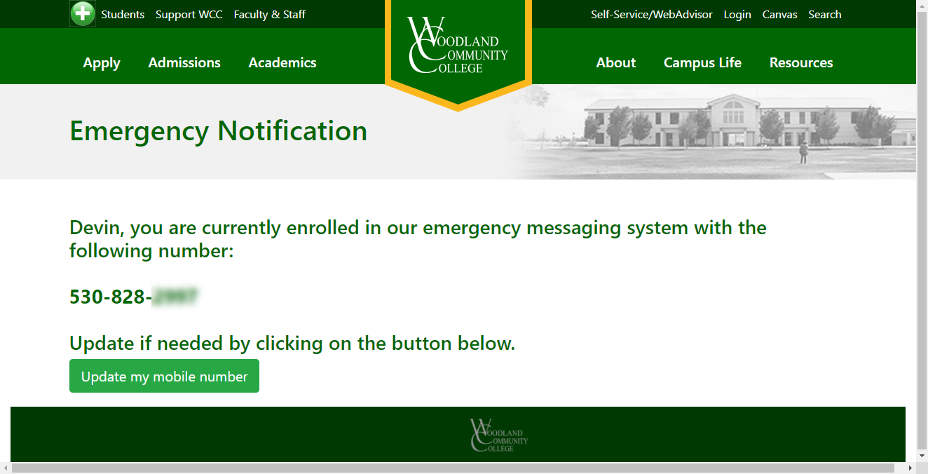

Slide 29
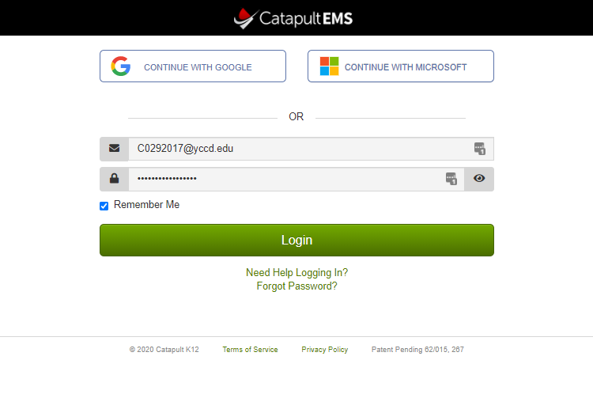
Catpultems.com

Slide 30
Adding CatapultEMS to your phone (Android)
Android Instructions
Go to www.catapultems.com
Step 1 - To place bookmark, tap the menu icon at the top-right of your screen. If you do not see the top-right menu, please open the link in Chrome.
Step 2 - Tap on “Add to home screen.”
Step 3 – Verify title for home screen and click “Add”
Step 4 – Press and drag home screen icon to the where you want it.
iPhone Instructions
Go to www.catapultems.com
Step 1 - To place bookmark, tap on the Send / Share Icon at the bottom of the screen.
Step 2 - Tap on “Add to Home Screen” icon.
Step 3 - Confirm “Catapult EMS” as your App title and click “Add”. Note: If you wish to name this something else, you may. Keep it short to fit under the icon.
Step 4 - The Catapult EMS icon will appear in the first available app location on your iPhone! Note: Move this icon to a primary position on your phone for quick access!

Slide 31
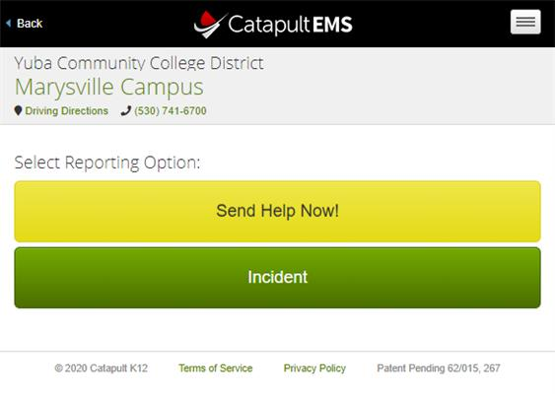
Reporting Options

Slide 32
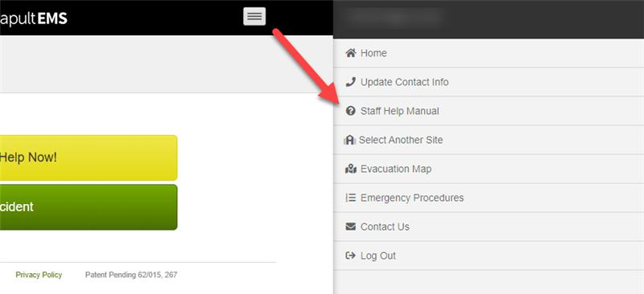
Additional Help

Slide 33
Chancellor’s Office System Webinars
Bi-weekly webinars on Wednesdays at 9-10 a.m. focused on updates, guidance and supports from the State Chancellor’s Office
Register for the Chancellor's Office System Webinars at https://cccconfer.zoom.us/webinar/register/WN_CfxTATY4S6WrnDIqHLn7qg
Registration is only required one time for the Chancellor’s Office System Webinars. Once registered, you will gain access to all of the webinars listed in the calendar.

Slide 34
Where to find CCCCO Memos and Other Resources…
https://www.cccco.edu/About-Us/Chancellors-Office/Divisions/Communications-and-Marketing/Novel-Coronavirus

Slide 35
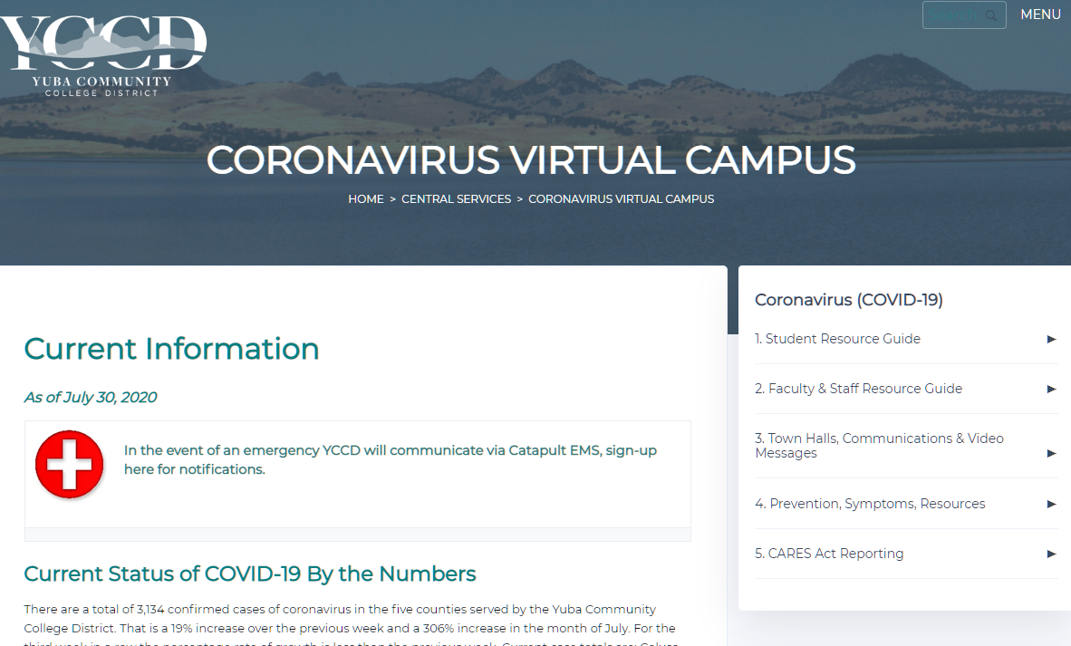
Resources – District Covid-19 Page
https://www.yccd.edu/central-services/coronavirus-covid-19/
Current Status
Faculty & Staff Resource Guide
Employee Toolkit
Safety Tips for Faculty
Canvas Tutorials
Zoom Tutorials
Camtasia Tutorials
SnagIt Tutorials
Links
Vision Resource Center
CCCC CAVID-19 Page
CVC-OEI Support Library
Online Resources for Science Labs
3CSN Zoom Sessions

Slide 36
Next YCCD Town Hall: November 2, 2020
To join these webinars please visit:
https://cccconfer.zoom.us/j/92584158141
Or iPhone one-tap (US Toll):
16699006833,92584158141# or +13462487799,92584158141#
Or Telephone (US Toll):
+1 669 900 6833 or +1 346 248 7799 or +1 253 215 8782 or +1 301 715 8592 or +1 312 626 6799 or +1 646 876 9923
Meeting ID: 925 8415 8141

Slide 37
Questions & Answers

